Slide 1

Docker Workshop
By Abdallah Al Fraijat

Slide 2
Agenda
Docker overview
Why use Docker?
Navigating Docker Desktop
Essential Docker commands
What is docker-compose?
Practice

Slide 3
Your fellow developer has prepared the program!

Slide 4
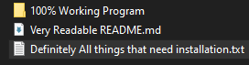
Time to get to installing it

Slide 5
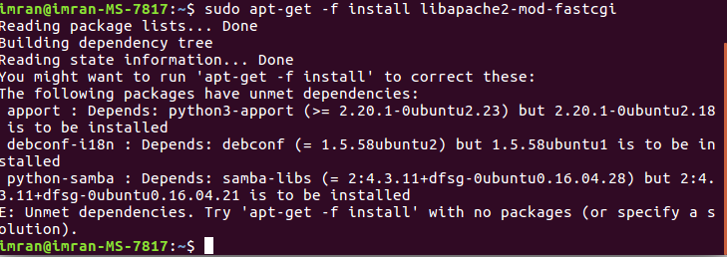


Slide 6

Docker Overview

Slide 7
Docker Overview
What is Docker?
Docker is an open platform for developing, shipping, and running applications. Docker enables you to separate your applications from your infrastructure so you can deliver software quickly.
This separation is possible due to containers. Containers are lightweight and contain everything needed to run the application, so you do not need to rely on what is currently installed on your own machine.

Slide 8
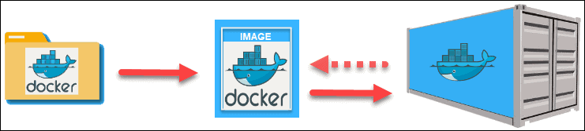
Docker Overview
How is a container created?
To be able to create and run a container, it requires a template to use in the form of an image. An image is built using a set of instructions that are defined in a Dockerfile.

Slide 9
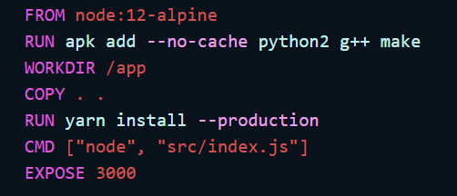
Dockerfile example

Slide 10
Why use Docker?
No need to manage the dependencies
Isolating the program from your machine
End-result will “always” be the same
Modularity
Packaging
Ease of running containers

Slide 11
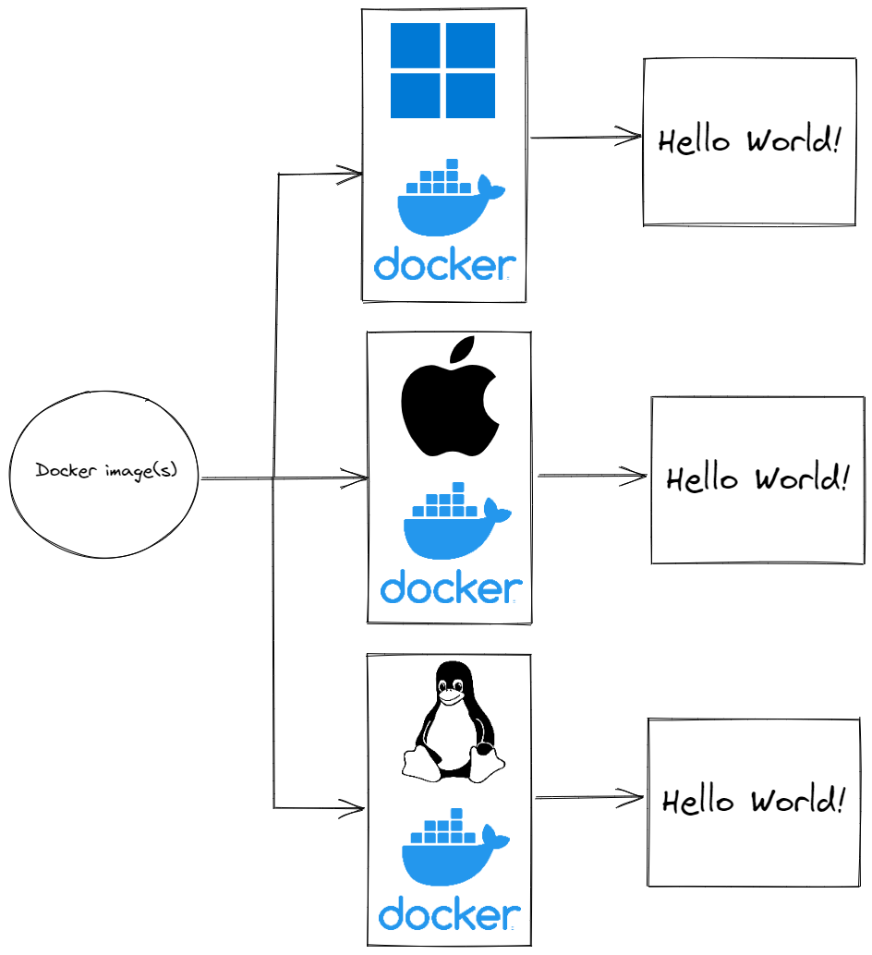
Why use Docker?
A simple Hello World app

Slide 12
Interacting with Docker

Slide 13
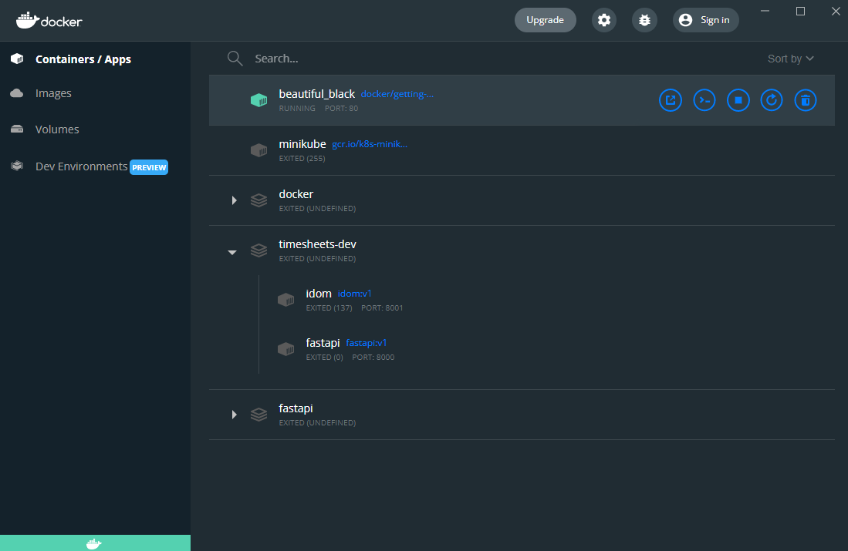







Navigating Docker Desktop
1) Container’s name, view logs
2) Open page
3) Container’s CLI
4) Stop container
5) Restart container
6) Delete container
7) Example of multi-containers

Slide 14
Essential Docker commands
docker pull [image_name]
docker build [Dockerfile_location] -t [created_img_name]
docker run --name [created_cont_name] [img_name]
docker-compose up
Pulls the requested image from the Docker Hub Container Image library.
Build an image from a Dockerfile. You can optionally specify the name of the image; by default, the name is randomly generated
Create and run a container using an image built previously.
Use the docker compose file in the current directory to spin up container(s). This essentially brings up the whole project.

Slide 15
What if I can’t fit my whole application into a single container?

Slide 16
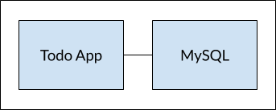
What is docker-compose?
Enter, docker-compose
Docker-compose is a tool for defining and running multi-container Docker applications. It allows you to spin up multiple Dockerfiles at once with a single command.

Slide 17
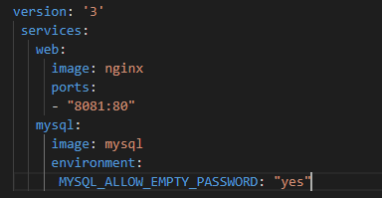
Docker-compose example

Slide 18
Exercises overview
What will we be doing?
1) Simple Hello world app using Dockerfile
2) FastAPI and MkDocs with docker-compose

Slide 19
Practice time!

Slide 20

Thanks!
Contact us:
ul. Czyżówka 14/0.3, 30-526 Kraków Poland
hello@dyvenia.com www.dyvenia.com

